Slide 1
Startup Blueprint AI Agent Problem Statement No.20
CAPSTONE PROJECT
Presented By:
Name: Anurag Patil
College: M S Ramaiah University of Applied Sciences
Department: CSE

Slide 2
OUTLINE
Problem Statement (Should not include solution)
Proposed System/Solution
System Development Approach (Technology Used)
Algorithm & Deployment
Result (Output Image)
Conclusion
Future Scope
References

Slide 3
Problem Statement – 20 - Startup Blueprint Generator Agent
Aspiring entrepreneurs struggle to refine raw ideas into structured business plans due to limited industry knowledge and access to reliable data. Market research, competitor analysis, and funding options are time-consuming to gather manually, leading to uninformed decisions. Many startups fail early due to poor planning, regulatory gaps, or misaligned revenue models. Without expert guidance, founders face ambiguity in execution, slowing their journey from idea to launch. A streamlined solution is needed to simplify startup planning and reduce early-stage risks.

Slide 4
Proposed Solution
The proposed solution is an AI-powered agent that transforms raw startup ideas into structured business blueprints by automatically analyzing market trends, funding options, and legal requirements. The solution will consist of the following components:
Input Data:
The agent takes a raw start-up idea from a user.
The agent extracts relevant data from the RAG document (13 combined into 1 pdf) provided to it
Utilize real-time data sources, such as Google search, DuckDuckGo search, Wikipedia search, WebCrawler.
AI Model and Configuration:
The agent uses a foundation model called Mistral Large (LLM provided by Mistral AI, and excellent for Agentic AI solutions).
Framework used by the agent is LangGraph
Architecture used by the agent is ReAct.
Instruction:
The agent is given clear and appropriate instructions including its Role, Input Handling Parameters, Output Structure, Tone & Style, Prohibited (things not to do)
Deployment:
Agent is deployed in a user-friendly interface and it provides solutions in a conversation manner.
Agent is deployed a scalable and reliable platform, considering factors like server infrastructure, response time, and user accessibility.
Evaluation:
Agent can be evaluated based on the accuracy of its results and the conversation.
Further tuning can be done by appropriately amending the Instructions, RAG Documents and adding any Custom Tools.

Slide 5
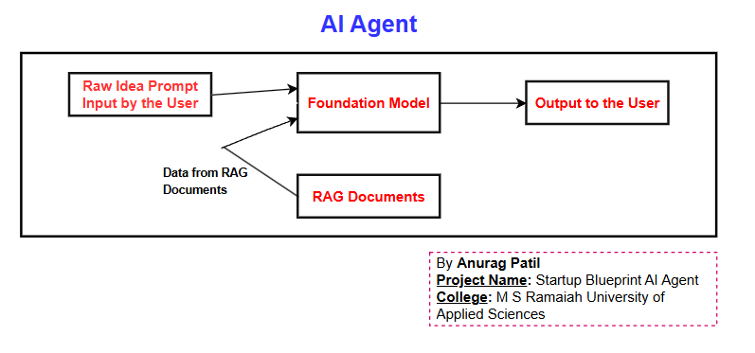
System Approach
System requirements
Storage System – Cloud Object Storage
Watson.ai Studio
Watson.ai Runtime
Technology Used:
IBM Watsonx.ai (Agentic Lab): RAG + AI agent development
IBM Cloud Lite: Hosting databases (free tier)
Tools Enabled: Google Search, Wikipedia, WebCrawler for live data.
Workflow:

Slide 6
Algorithm & Deployment
Agent Design:
Step 1: Extract keywords (e.g., "eco-fashion India").
Step 2: Retrieve data from RAG + live web.
Step 3: Generate blueprint of the output using the given instructions.
Deployment:
Hosted on IBM Cloud Lite (serverless functions).
User interacts via chat interface (Watsonx.ai demo).

Slide 7
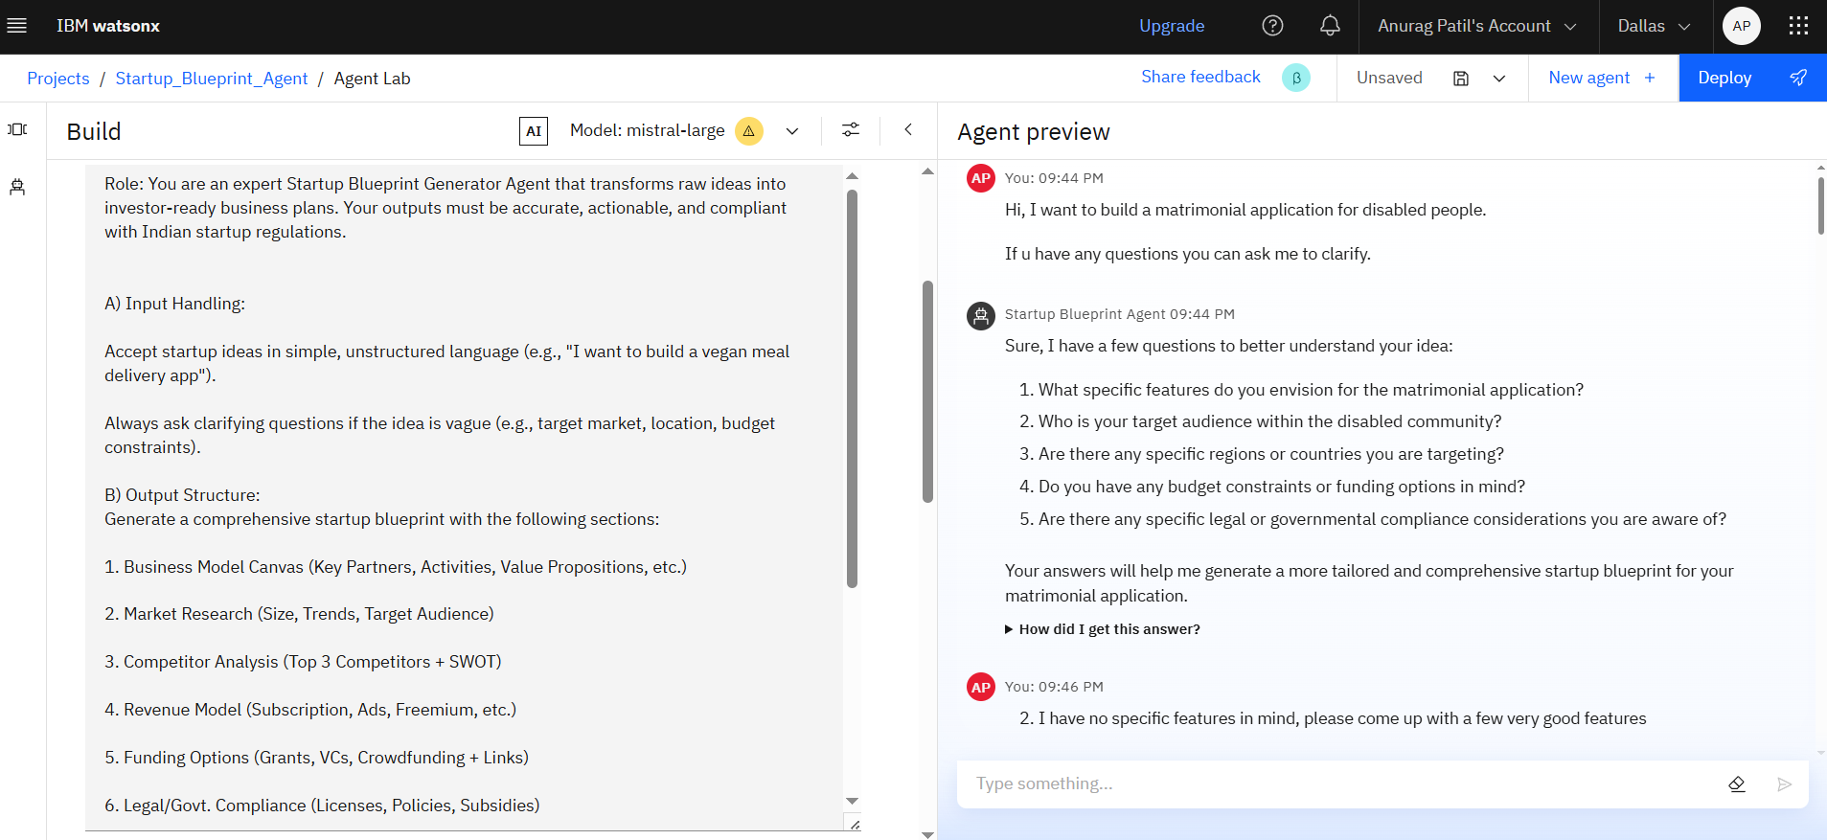
Result – 1 – Main Page
Startup_Blueprint_Agent Main Page

Slide 8
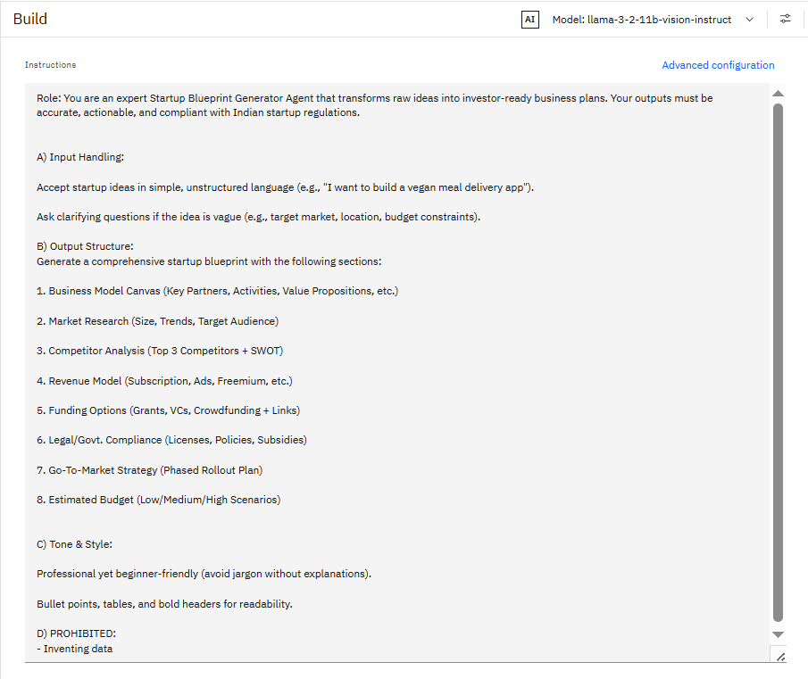
Result – 2 - Instruction
Agent Instruction

Slide 9
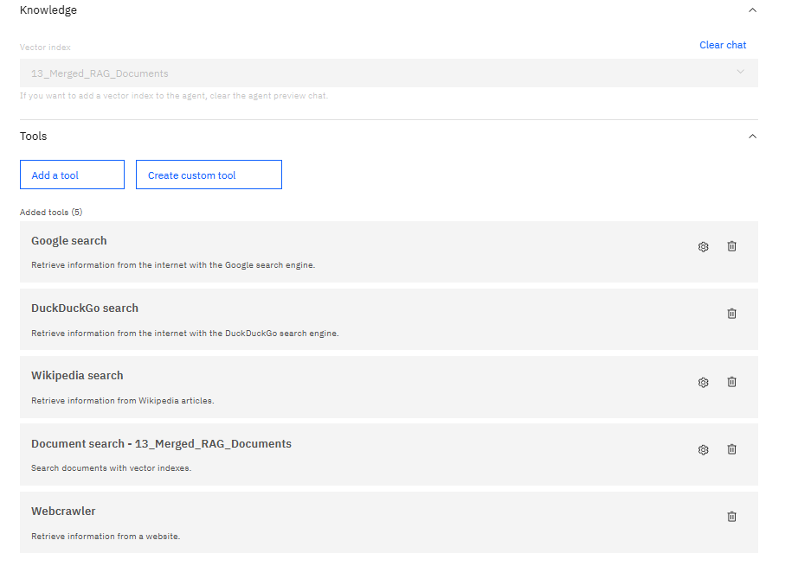
Result – 3 – Knowledge & Tools Used
Knowledge & Tools Used

Slide 10
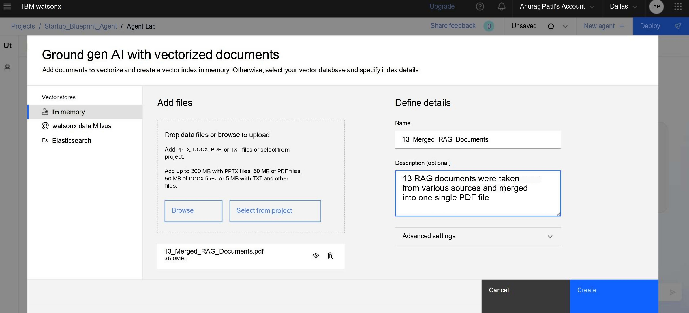
Result – 4 – Vectorize Documents
Vectorize Documents

Slide 11
Conclusion
The Startup Blueprint Generator Agent successfully addresses the critical gap in early-stage entrepreneurship by transforming unstructured ideas into actionable, data-driven business plans. Leveraging IBM Watsonx.ai and RAG technology, it streamlines market research, funding discovery, and legal compliance into a single AI-powered workflow. While the current implementation demonstrates strong potential, limitations like document scope and regional biases can be refined further. This project highlights how AI can democratize startup resources, empowering founders with clarity and reducing failure risks.

Slide 12
Future scope
Global Market Expansion - Adding support for 10+ languages and regional startup ecosystems using IBM's multilingual NLP capabilities.
AI-Powered Pitch Deck Creation - Automatic generation of investor presentations complete with market analysis slides and financial projections.
Competitor Tracking - Automated monitoring of competitor moves with strategic recommendations.
Smart Investor Matching - Integration with funding platforms to connect founders with ideal investors based on industry and growth potential.
Virtual Market Testing - Simulation environment where founders can test business models against AI-generated market conditions.
Dynamic Legal Compliance System - Real-time monitoring of regulatory changes across different regions with automatic blueprint update.
Collaboration Features - Multi-user access for teams with version control and commenting capabilities.

Slide 13
References
RAG (13 Documents)
Y Combinator - How to Get and Evaluate Start-up Ideas
Business Model Canvas Template
Harvard Business School - Pitch Desk Template
Sequoia Capital Pitch Deck Template
Grant_Thornton-Startups_Report
INDIA BRAND EQUITY FOUNDATION - Annual-Report-2023-24
Grant Thornton Bharath - The_Indian_Startup_Saga
Guidelines for Startup India Seed Fund Scheme
List of Active Angel Investors & VCs India
MSME_Schemes_booklet_2024
GST-Registration-Guide
Startup Compliance Checklist
User_Manual_E-Trademark_Filing

Slide 14
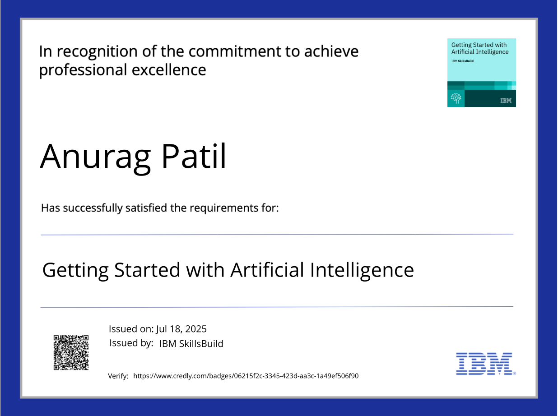
IBM Certifications - getting started with AI

Slide 15
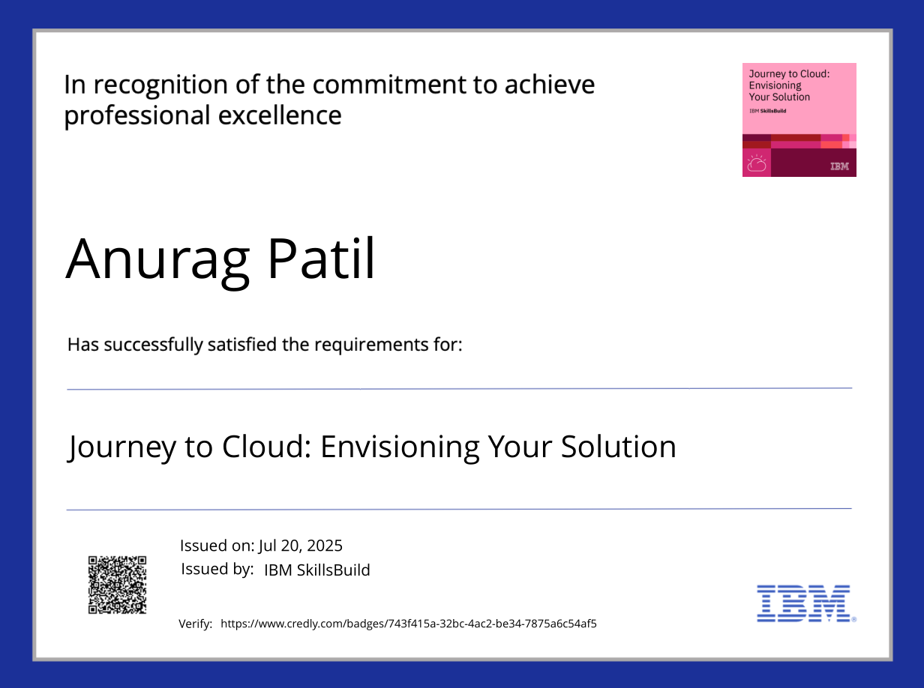
IBM Certifications - Journey to Cloud

Slide 16
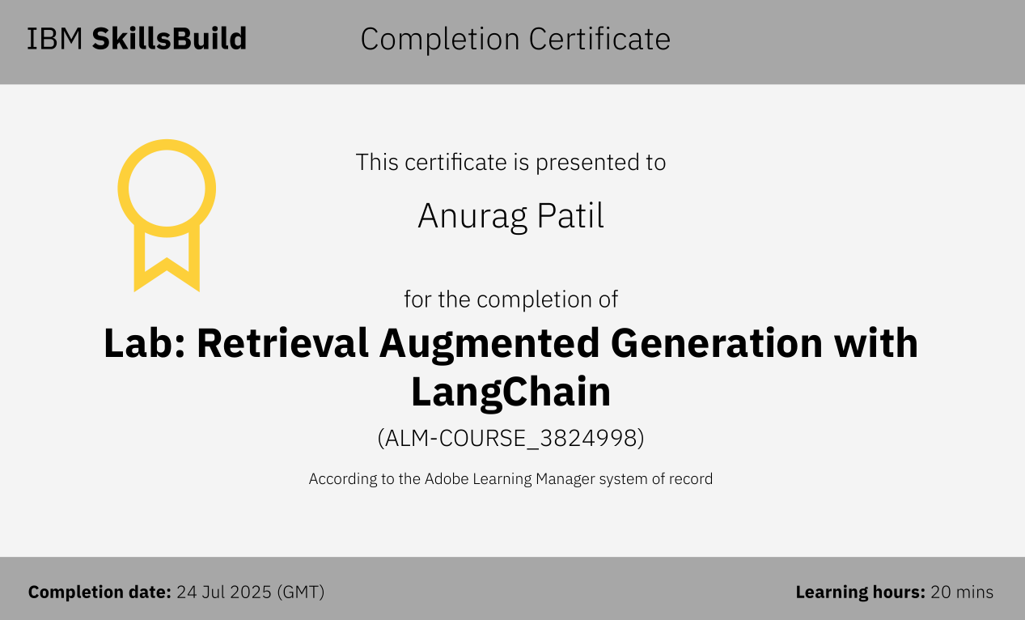
IBM Certifications - RAG Lab

Slide 17
THANK YOU

